Slide 1
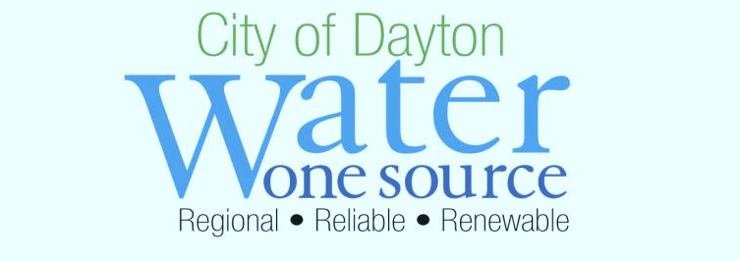
SMALL BUSINESS OPPORTUNITY FORUM
Water Department
2015 Capital Program
&
2016 Outlook

Slide 2
Water Department
Water Department has Six Divisions
Water Administration
Water Utility Field Operations
Environmental Management
Water Supply and Treatment
Water Reclamation
Water Engineering / Water Information Management Systems

Slide 3
Water Department
City of Dayton owns/operates Three Utilities
Water
Approx. 800 miles of water distribution piping
Elevated storage tanks/booster pump stations
2 Water Treatment Plants (Miami & Ottawa)
Sanitary
Approx. 740 miles of wastewater collection piping
Lift Stations & Force Mains
1 Water Reclamation Plant
Storm
Approx. 700 miles of storm collection piping
Lift Stations, Force Mains & Flood Control

Slide 4
Capital Program Overview
In 2013, the Water Department Launched a formal System Re-Investment Program. Program highlights include:
Re-Investing $160 million in Repair/Replacement (R/R) Program over 10-year Period (2013 – 2022)
$8 Million per year for water distribution system
$8 Million per year for wastewater collection system
Repair/Replacement (R/R) Program goal is to replace/upgrade 1% of the system per year
8.0 linear miles of water distribution mains
7.4 linear miles of wastewater collection sewers

Slide 5
2015 Capital Program
32 Construction Contracts Awarded using $25.0 Million in Water Department capital funds
$11.4 Million from Water Capital
$11.5 Million from Sanitary Capital
$2.1 Million from Storm Capital
13 Water Main Improvement construction contracts awarded for $7.2 Million to improve 5.33 linear miles of Water Mains
14 Sanitary Sewer Improvement construction contracts awarded for $11.5 Million to improve 34.63 linear miles of Sanitary Sewers

Slide 6
2015 Capital Program
Expenditures of Water Department capital funds was $29.2 Million
Expenditures made via Construction Contracts, Service Contracts and Purchase Orders
$13.5 Million from Water Capital
$14.4 Million from Sanitary Capital
$1.3 Million from Storm Capital
Summary of Expenditures
$6.6 Million for Water Main Improvements
$6.4 Million for Water Supply & Treatment Improvements
$7.4 Million for Sanitary Sewer Improvements
$6.7 Million for Water Reclamation Improvements
$1.2 Million for Storm Sewer Improvements

Slide 7
2013-2015 Program Summary
86 Construction Contracts Awarded using $61.7 Million in Water Department capital funds
$33.1 Million from Water Capital
$25.8 Million from Sanitary Capital
$2.8 Million from Storm Capital
40 Water Main Improvement construction contracts awarded for $23.7 Million to improve 18.55 linear miles of Water Mains
22 Sanitary Sewer Improvement construction contracts awarded for $16.6 Million to improve 57.48 linear miles of Sanitary Sewers

Slide 8
2013-2015 Program Summary
Expenditures of Water Department capital funds was $64.2 Million
Expenditures made via Construction Contracts, Service Contracts and Purchase Orders
$33.9 Million from Water Capital
$26.9 Million from Sanitary Capital
$3.4 Million from Storm Capital
Summary of Expenditures
$18.3 Million for Water Main Improvements
$13.0 Million for Water Supply & Treatment Improvements
$14.3 Million for Sanitary Sewer Improvements
$10.4 Million for Water Reclamation Improvements
$2.6 Million for Storm Sewer Improvements

Slide 9
2016 Outlook
Water Distribution System – Continue with Repair/Replacement Program
Wastewater Collection System – Phase 1 of the Sanitary Interceptor Sewer Improvements, Bid in Nov/Dec 2016 (over $5 Million)
Water Supply & Treatment – Lime Reclamation Facility Expansion Project, Bid Opening on 2/18 with the Low Bid being $9.1 Million
Water Reclamation – Final Clarifier Improvements, Bid in May/Jun 2016 (over $5 Million)

