Slide 1



Intro to C&ED: Minority Business Opportunity Forum

Slide 2

WHO WE ARE:

Slide 3

Business Retention & Expansion (BRE)
Community
Development
MCOFuture Initiative
HOW WE HELP SMALL BUSINESSES

Slide 4

Business Retention & Expansion (BRE)
HOW WE HELP SMALL BUSINESSES

Slide 5
Regional BRE Program
Customer-focused program that gives businesses a single point of contact for a wide range of services
Regional organization with approximately 30 member jurisdictions across six counties
Outreach specialists work to connect businesses with over 100 community resource partners
Keeps a pulse on the companies in your community
BUSINESS RETENTION AND EXPANSION

Slide 6
A Typical BRE Visit:
High-level Executive
  President/C-Level/Operations Manager
  Someone who can answer questions about the overall business
Conversation vs. Survey
  What is the biggest challenge or opportunity facing your business?
  Does the company have growth plans?
  What are the projected revenues in the next year at this location?
  Do you have problems recruiting new employees?
  How would you rate the local business climate?
  How would you rate Community Services
BUSINESS RETENTION AND EXPANSION

Slide 7
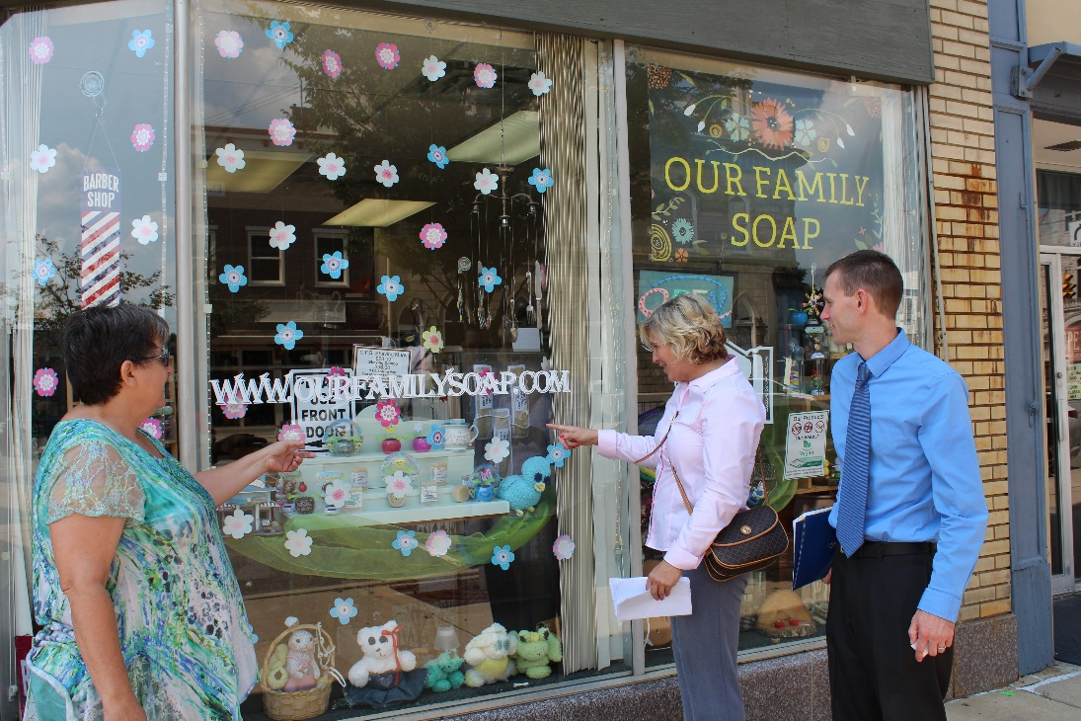
Working together:
Outreach specialists have conducted over 7,000 BRE visits with regional companies since 2001
BusinessFirst! communities annually coordinate and prioritize business visits
  Priority sectors, major employers, company news, etc.
BusinessFirst! holds trainings and webinars to improve the competency of regional economic development professionals
BusinessFirst! also conducts community business walks to assist small, “mom and pop” businesses
BUSINESS RETENTION AND EXPANSION

Slide 8
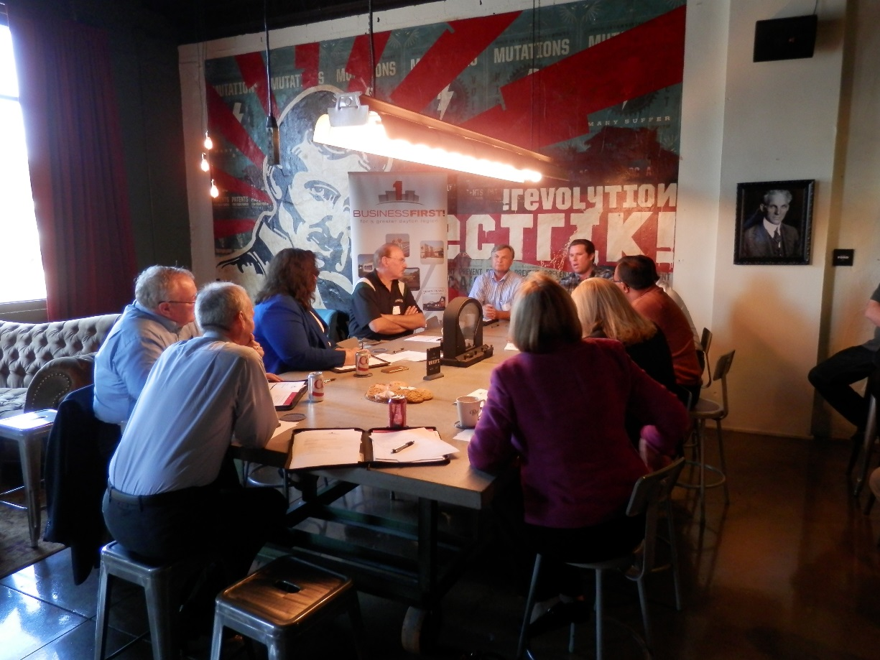
Working together:
BusinessFirst! also hosts Roundtables to learn about the issues and opportunities faced by industries in the Dayton Region
BusinessFirst! plans to host small business roundtables in 2016
  MBE/WBE/VBE
Feedback is used to shape regional strategic initiatives
  Workforce Training, BF! Relocation
BUSINESS RETENTION AND EXPANSION

Slide 9
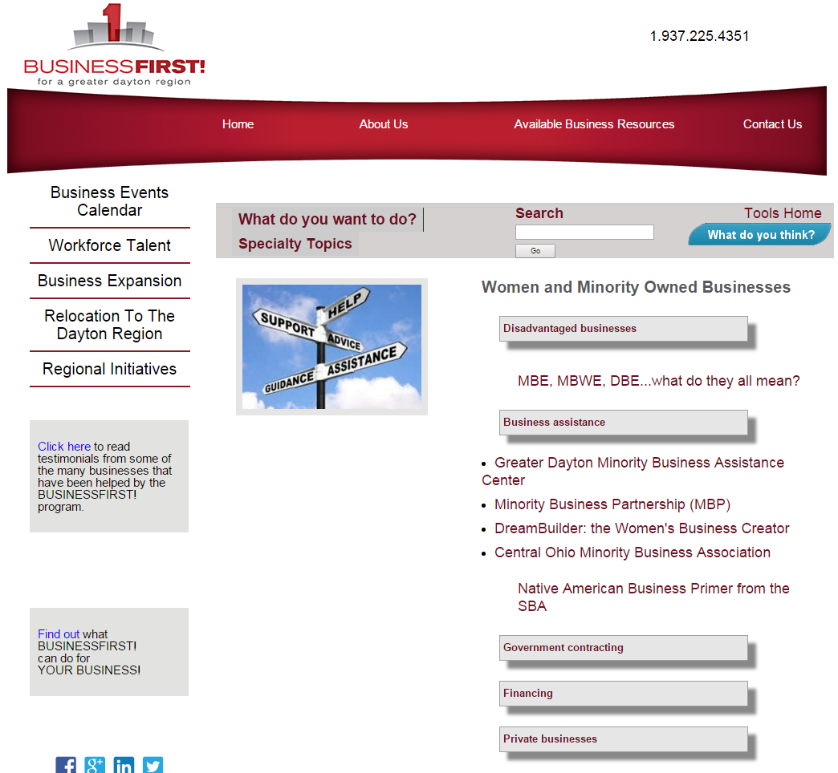
BusinessFirst! Website
www.bfdr.online
Includes portal to request BRE visit from BusinessFirst!
Also includes “Tools for Business Success” module has over 600 resources to help companies
BUSINESS RETENTION AND EXPANSION

Slide 10

Community
Development
COMMUNITY DEVELOPMENT PROJECTS

Slide 11
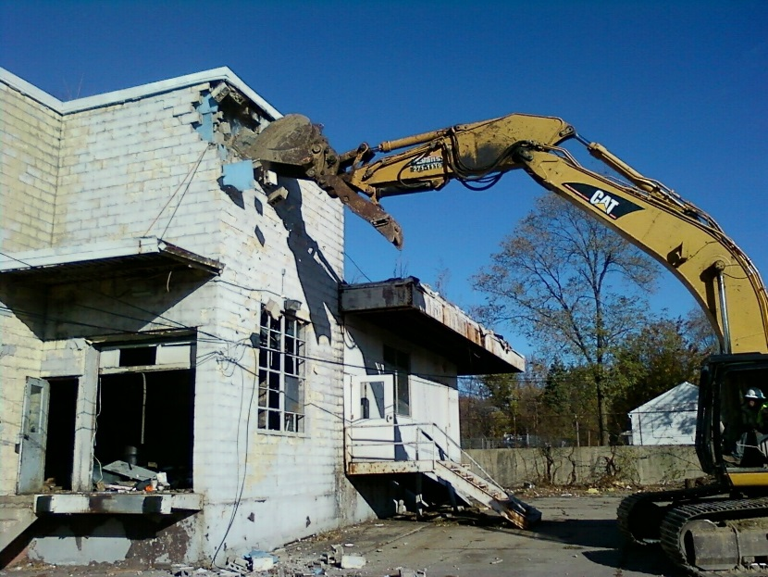
Montgomery County Community Development Programs
Montgomery County annually receives HUD funds
  Community Development Block Grant (CDBG) and HOME Investment Partnership Program (HOME) funds
Funds are used for public infrastructure improvements, community centers, parks, demolition, and housing development
Each project carries MBE/WBE/Section 3 goals
  Refer contractors to MBAC Procurement Enhancement Program (PEP) Certification List
  Review outreach efforts prior to approving contract award
COMMUNITY DEVELOPMENT PROGRAMS

Slide 12
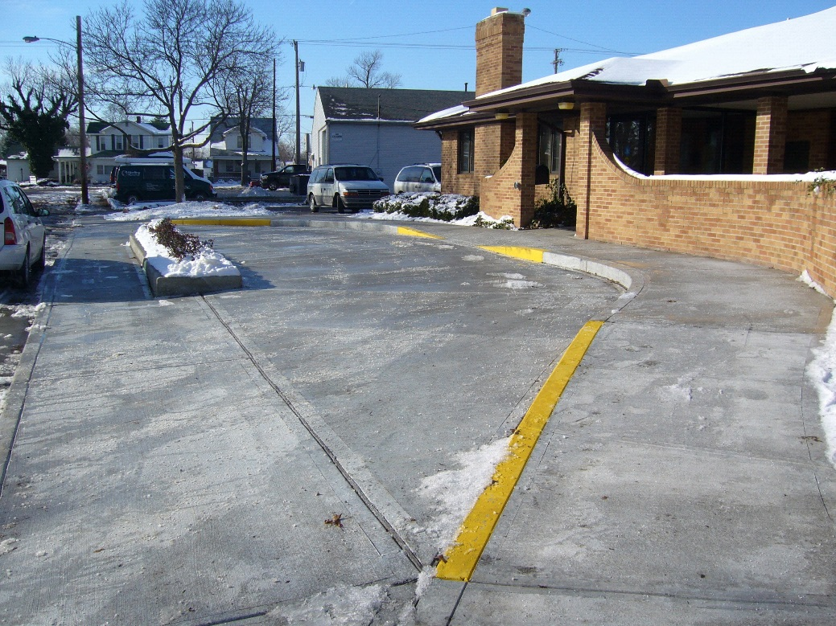
2016 Community Development Work Plan
CDBG Projects:
  Brookville Sidewalk Improvements
  Butler Township Willowbrook Street Improvements
  Centerville Johanna Drive Street Improvements
  Englewood ADA Restrooms
  Harrison Township Street Improvements
  Miamisburg ADA Infrastructure Improvements
  Riverside Demolition
  Vandalia Water Main Replacement
  Verona Sandhurst Street Reconstruction
  Washington Township ADA Park Improvements
  West Carrollton Demolition
COMMUNITY DEVELOPMENT PROGRAMS

Slide 13

MCOFuture Initiative
MCOFUTURES INITIATIVE

Slide 14

Goal: Target the county’s economic development assistance to small businesses
  Re-allocate up to $1 million per year of ED/GE funds to small and emerging businesses that show potential job creation
  Include language in our agreements with vendors, contractors and grantees to encourage inclusion of fully qualified, small and emerging businesses as primary participants and subcontractors
  Lead an effort to encourage more businesses to support fully qualified, small and emerging business as primary participants and subcontractors
  Accelerate efforts to bring state-of-the-art broadband and high speed, fully network enabled wireless capacity to every business and residence throughout the county
MCOFUTURES INITIATIVE

Slide 15
Vendor Registration:
Ties into MCOFuture Initative
  Small and minority business enterprises are encouraged to participate
Purchasing Department acquires equipment and supplies necessary for County operations
County issues over 7,000 purchase orders annually
County maintains vendor list for purchasing
  Organized by item/service
  Businesses can register to receive Notifications of Invitation to Bid
  Awards are made based upon price and quality
mcohio.org/departments/purchasing/index.php
MONTGOMERY COUNTY VENDOR REGISTRATION

Slide 16
Michael Norton-Smith
Community & Economic Development Specialist
Montgomery County
(937) 224.3848
SmithMN@mcohio.org www.bfdr.online
CONTACT INFORMATION

